Slide 1

Machine Learning

Slide 2
Types of Machine Learning
Supervised learning
→ Given: training data with labels
Unsupervised learning
→ Given: training data (without desired outputs)
Semi-supervised learning
→ Given: training data + a few desired outputs
Reinforcement learning
→ Rewards from a sequence of actions

Slide 3
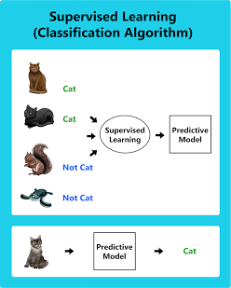
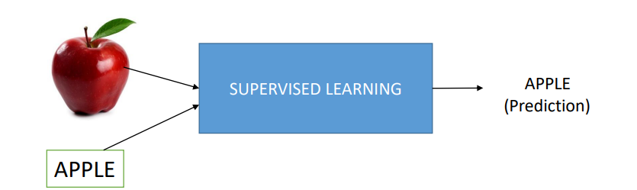

Supervised Learning
→ Given: training data + desired outputs
The algorithm learns from labeled data to make predictions or decisions
Image Source: ML Based Chat Analysis

Slide 4
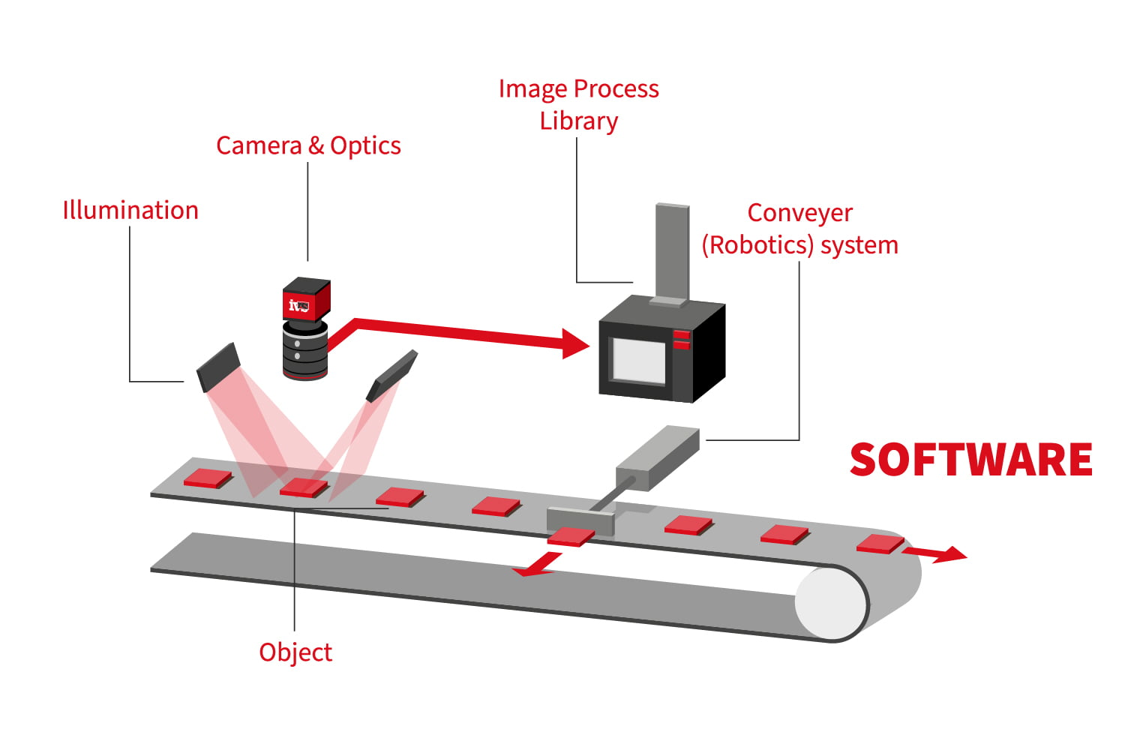
Defect Identification System
Image Source: IndustrialVision

Slide 5
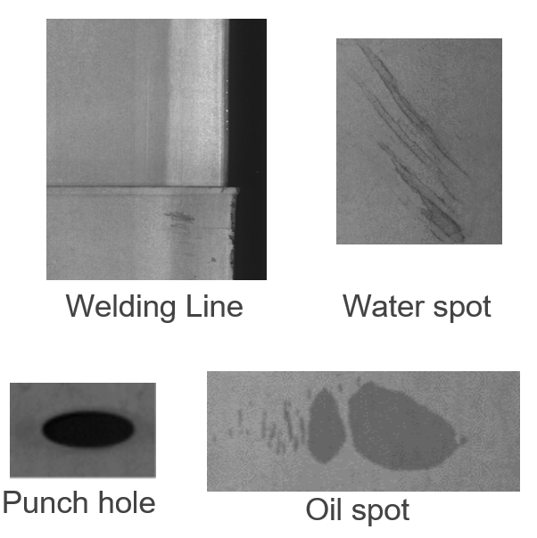
Data Set
10 different defect types
→ Punching hole
→ Welding line
→ Crescent gap
→ Water spot
→ Oil spot
→ Silk spot
→ Inclusion
→ Rolled pit
→ Crease
→ Waist folding

Slide 6
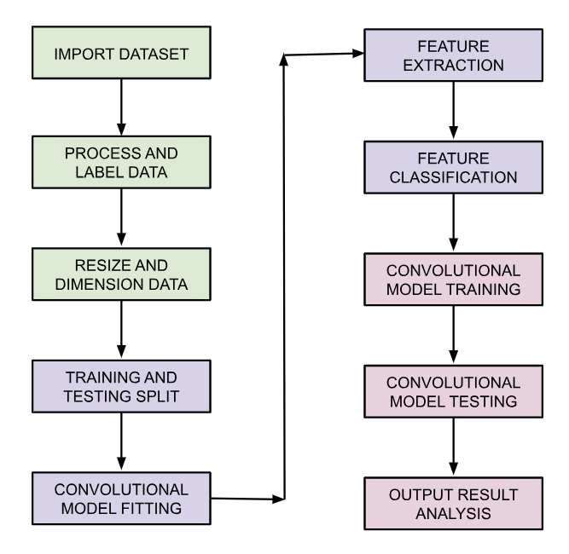
Methodology
Notes:
20% Split Ratio

Slide 7
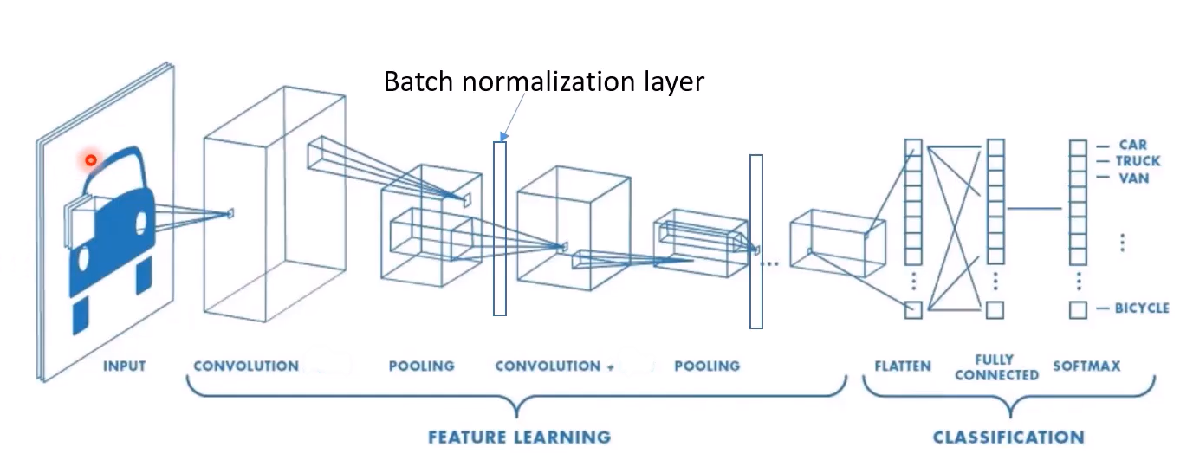
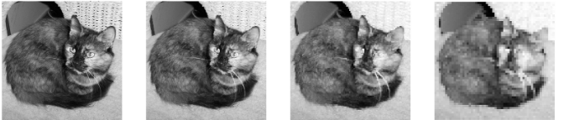
Model Architecture
Feature Learning:
4 Convolution Blocks
→ Extract and process features
Pooling
→ Reducing the spatial dimensions
Classification:
Flatten
→ Spreads out the features
Fully Connected Network
→ Links them all together
SoftMax Activation
→ probability
Image Source: Convolutional Neural Network
Notes:
Max pooling: Focus on the important features of the picture while making it easier and faster to work with.
Flattening: see all the features at once and work with them more simply.
FCN: Each feature is connected to other features to combine knowledge. So, all information gets shared.
SoftMax: Decide what’s in the image. Guess on what it could be. Probability algorithm, fair decision

Slide 8
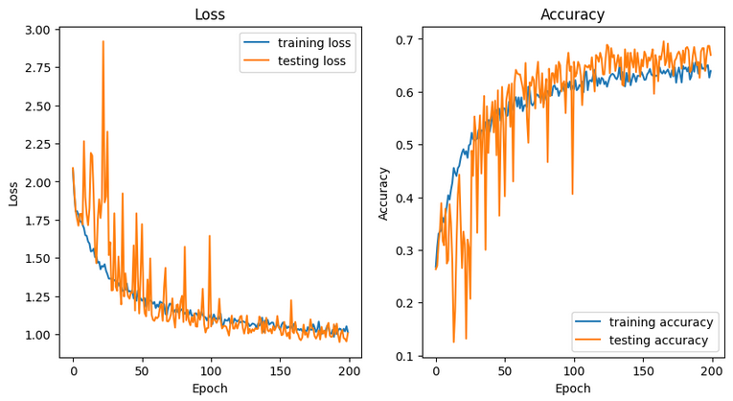
Model Training
Learning Rate: 0.1
Epoch: 200
Notes:
LR: controls the size of the step taken during the optimization process. it determines how quickly or slowly the model learns from the training data.
So, A higher learning rate may lead to faster convergence but can also cause instability or overshooting, while a lower learning rate may result in slower convergence but more stable training.
Epoch: One complete pass through the entire training dataset during the training of a machine learning model.

Slide 9
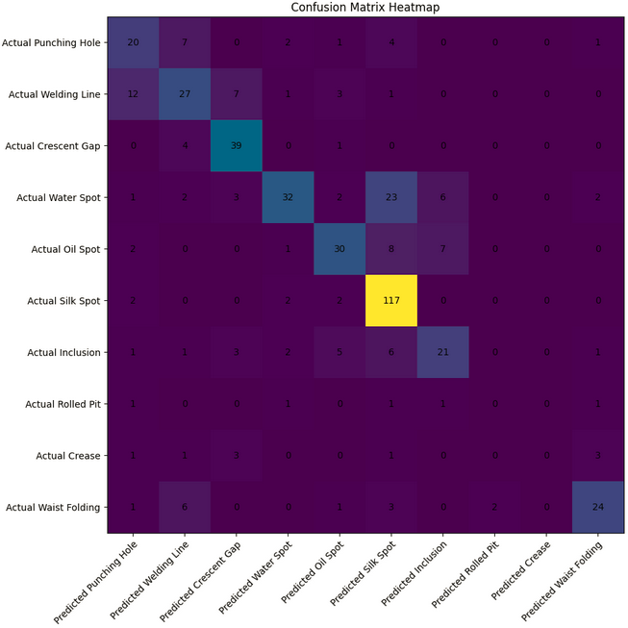
Testing & Results
Confusion Matrix
Accuracy: ~68%
Notes:
performance of a classification model,

Slide 10
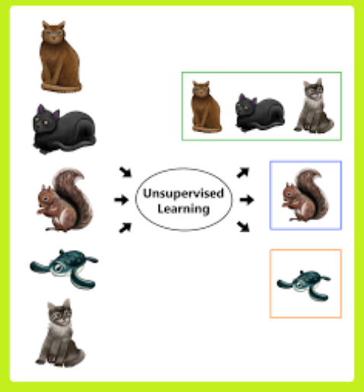
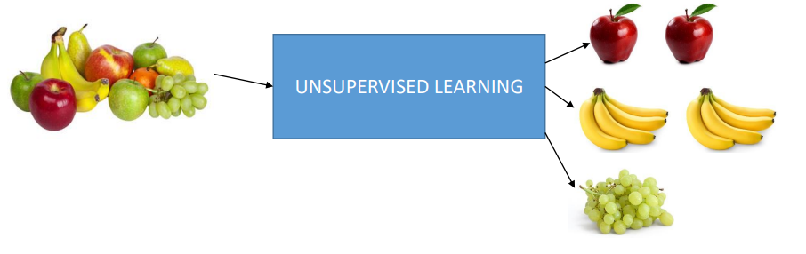
Un-Supervised learning
→ Given: training data (without desired outputs)
The Algorithm learns patterns and structures from unlabeled data without explicit guidance.
Image Source: ML Based Chat Analysis
Notes:
Ex: Sort them based on similarities like color, shape, or size.
groups data based on similarities or other patterns without any predefined labels

Slide 11
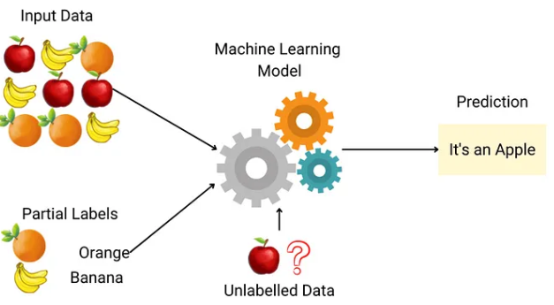
Semi - Supervised learning
Given: training data
+ A few desired outputs
Image Source: ML Semi
Notes:
the algorithm learns from both to make predictions, benefiting from the labeled data while also leveraging the additional unlabeled data to improve its performance.

Slide 12
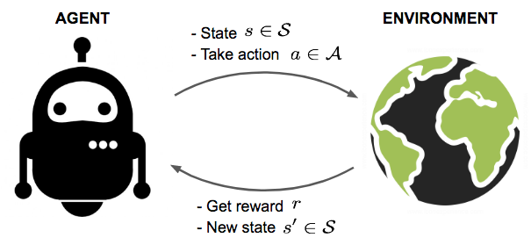
Reinforcement learning
Rewards from a sequence of actions
Controls Application: Q learning
Image Source: PeekRL
Notes:
An agent learns to make decisions by interacting with an environment. through trial and error, receiving feedback in the form of rewards or penalties, and adjusts its actions to maximize cumulative rewards over time.
Q learning: iteratively explores the environment, updating Q-values using the Bellman equation until convergence to the optimal policy is achieved.

Slide 13
References
Eaton, E. (2017). Introduction to Machine Learning CIS 419/519. University of Pennsylvania, Department of Computer Science.
MIT (2019), Intro to Machine Learning, MITOpenLearningLibrary, Department of Computer Science.
Hasti, V. (2023) AI for Engineering Applications MAE 589, North Carolina State University, MAE Department.
Fiona. (2020). Building Blocks Of Convolutional Neural Network. Analytics Vidhya, Medium.

